Slide 1

Airbnb Hotel Booking Analysis
Abu Obaida
INTERNSHIP_17546440516895be537820f

Slide 2

PROBLEM STATEMENT
The goal of my project is to analyze the Airbnb open dataset. It involves understanding factors that influence listing prices, exploring geographical distribution of properties etc. The main challenge is to finding missing values, clean and process a large, raw dataset with significant missing values to make it suitable for analysis.

Slide 3
Project Description 1. Data Loading and Inspection: Loading the dataset and examining its structure, size and how it looks. 2. Data Cleaning: This is the most important part in data analysis. It include extensive cleaning data to handle thousands of missing values, correct improper data types(e.g. price from text to numbers), and removing irrelevant columns. 3. Data Visualization: Creating charts from the final dataset we got after cleaning data using python libraries(such as Matplotlib and seaborn) to look and analyze easily.

Slide 4

WHO ARE THE END USERS?
Travelers/Guests: They can understand pricing in different areas, identify common types of listing, find trusted hosts etc.
Airbnb Hosts: Can use the insights to understand market trends, set prices and identify which factor attract customers.
Airbnb Business Analysts: Can monitor market dynamics, identify growth opportunities, and make data-driven decisions to improve the platform.

Slide 5

Technology Used
Programming Language: Python
Python Libraries:
Pandas: Used for manipulating and cleaning the data.
Matplotlib & Seaborn: Used for creating a wide range of data visualizations, including bar chart, box plots, histograms, and scatter plots.
Environment: Google Colab

Slide 6
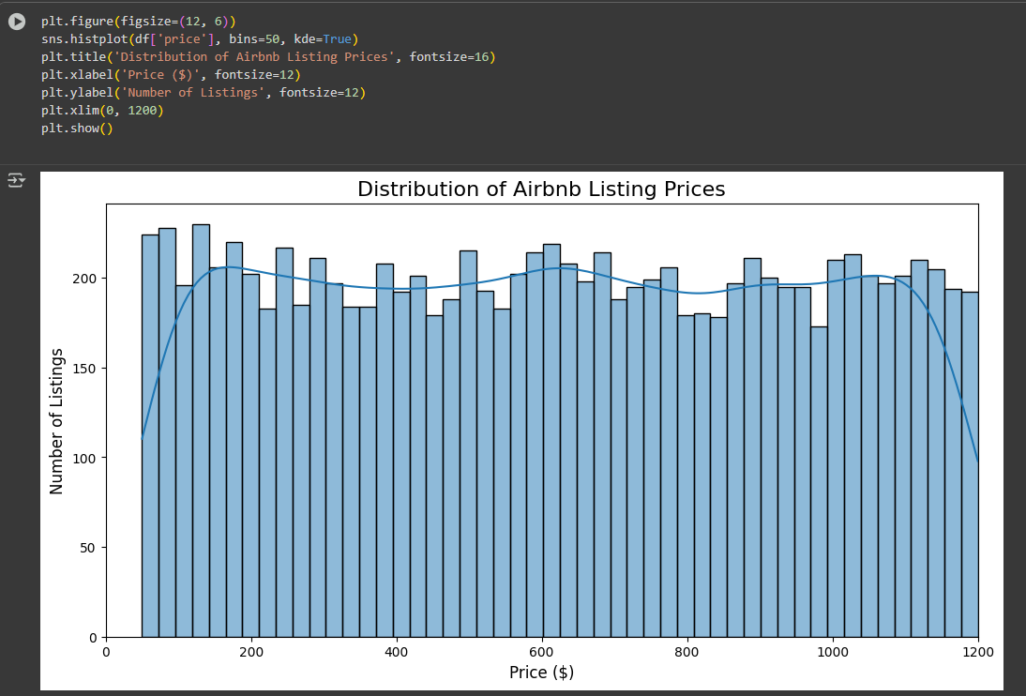
RESULTS1
[Add screen shots of your code or Chart(s) ]
Demo Link

Slide 7
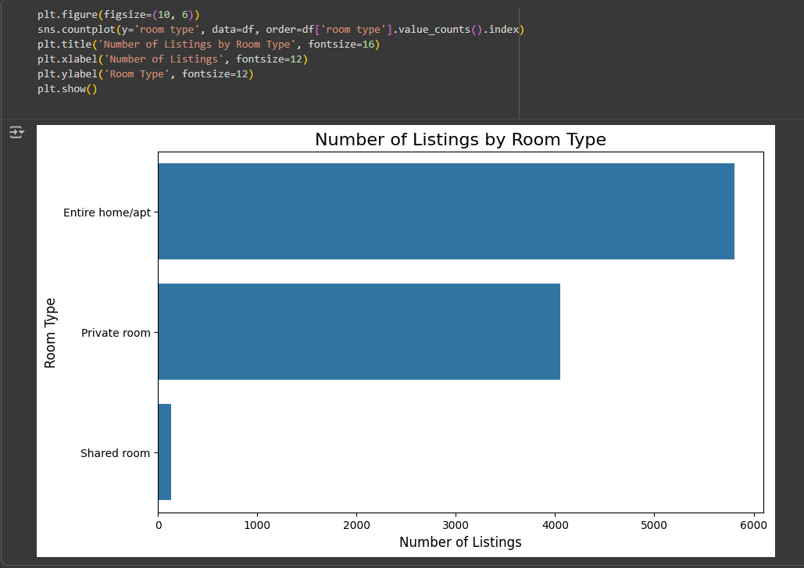
RESULTS2
[Add screen shots of your code or Chart(s) ]
Demo Link

Slide 8
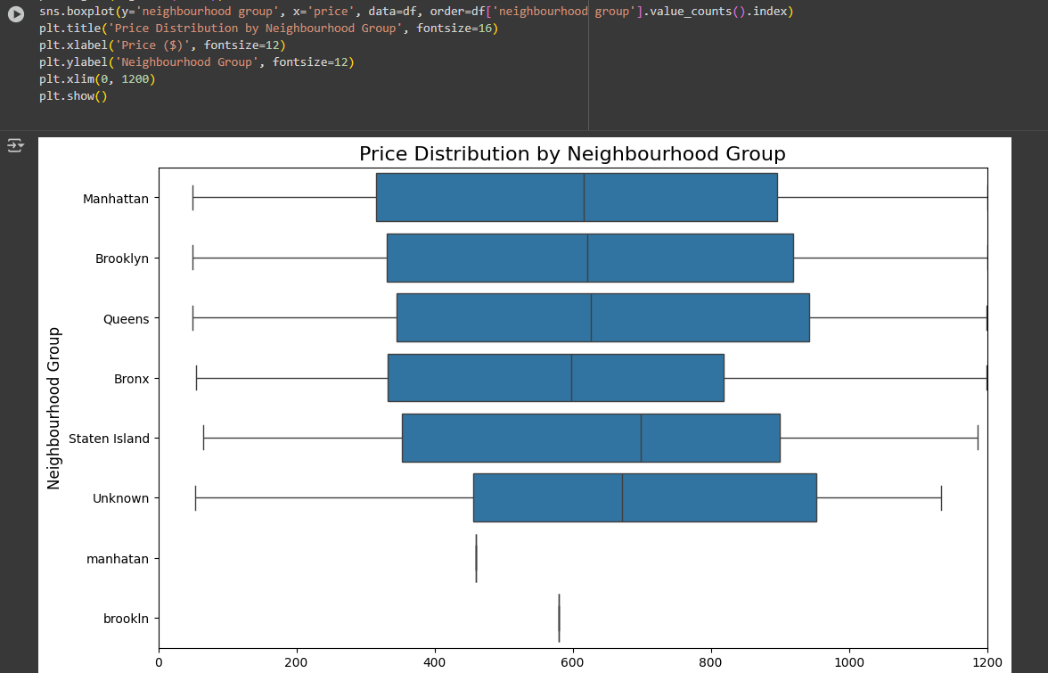
RESULTS3
[Add screen shots of your code or Chart(s) ]
Demo Link

Slide 9
GitHub repository
https://github.com/AbuObaida01/VOIS_AICTE_Oct2025_AbuObaida.git
Demo Link

Slide 10
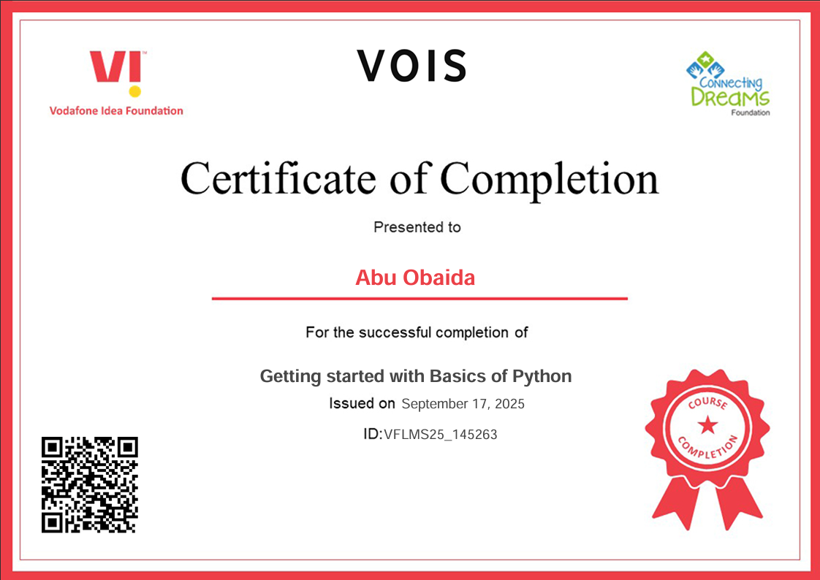
Getting started with Basics of Python Certificate
[Paste your Certificate Here]

Slide 11
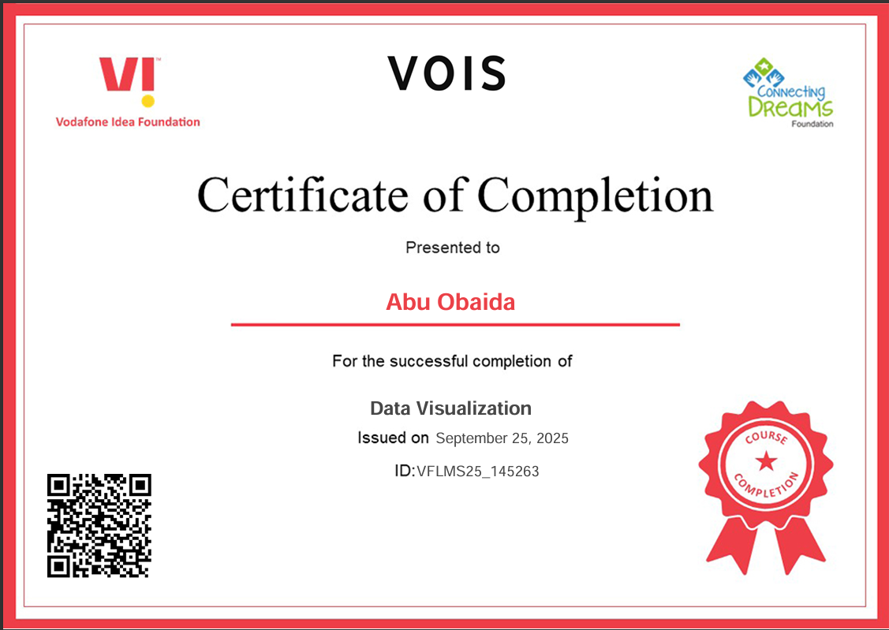
Data Visualization Certificate
[Paste your Certificate Here]

Slide 12
Thank you
.
.

